Slide 1
Python Introduction
Introduction to Python and Comparison with NodeJS

Slide 2
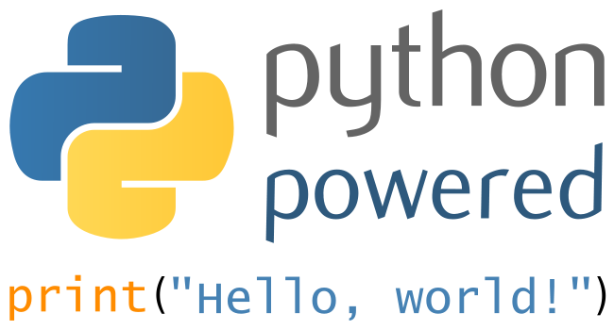
Python
Object-oriented
Interpreted
Interactive
Modular
Dynamic
High-level
Portable
Extensible in C and Java
Easy to read

Slide 3

Python Used For
Computational Science
Data Analysis
Mathematical Modeling
Statistic
GIS

Slide 4

Strong Points
Shallow learning curve
  Simple syntax
  Experienced programmer can pick it up in a day
  Be productive in a week or less
Easy to read: white space matters
Code can be grouped into modules and packages
Supports raising and catching exceptions
Popular in academia, creating large talent pool
Data types strongly, but dynamically, typed
Automatic garbage collection
Interactive mode makes it easy to test snippets
Interpreter can be embedded into an application
Easily extended
Open source
Supports OO, procedural and functional programming styles
Easily integrates, and extensible with C and Java

Slide 5

Python Weak Points
Lack of true multiprocessor support
  Concurrency possible, but not straightforward
Interpreted, so slower than compiled code
Weak in mobile computing - few mobile platforms have it available
Lack of true multiprocessor support
Absence of commercial backing

Slide 6

NodeJS Used For
Server-side processing is its forte
CLI tools
Web-enabled desktop applications
Robot control
  ‘Johnny-five’

Slide 7

NodeJS Strengths
Minimalist core
The Node can maintain thousands of open connections with clients, while constantly saving the data to the database.
The event-based model works great to make cascaded asynchronous requests to other parts of the application.
A large and responsive community combined with a fast speed of the technology development.
Dozens of modules supported.
JSON is the native format of object description.
If you use MongoDB, you may virtually forget of the serialization issue.
Allows for quick implementation of highly loaded REST services.

Slide 8

NodeJS Weak Points
Single-threaded
Callback-passing creates ugly tangled soup
Anonymous functions within anonymous functions within……
Memory process limit of 1.4GB on 64-bit machine
  Horizontal scaling required to use machine to its full capacity
Bigger memory footprint on the hard drive
  Every referenced version of a dependency are installed in the project folder
Caches modules by absolute path
  2 different versions imported independently
  Issue when module should be a singleton
Small core means large use of modules
  No standardization in how pieces play together
No name spacing
  An issue because of explosion of new modules
Hard to find a module of interest

Slide 9
Node.js vs Python: Code Samples
Node.js
Python
var sys = require("sys");
var http = require("http");
http.createServer(function (req, res) {
res.writeHead(200, {"Content-Type": "text/plain"});
res.end("Pong!\n");
}).listen(8088, "127.0.0.1");
sys.puts("Server running at http://localhost:8088");
def application(environ, start_response):
status = '200 OK'
output = 'Pong!'
response_headers = [('Content-type', 'text/plain'),
('Content-Length', str(len(output)))]
start_response(status, response_headers)
return [output]
--------
from gevent import wsgi
from pong import application
wsgi.WSGIServer(('', 8088), application, spawn=None).serve_forever()

Slide 10
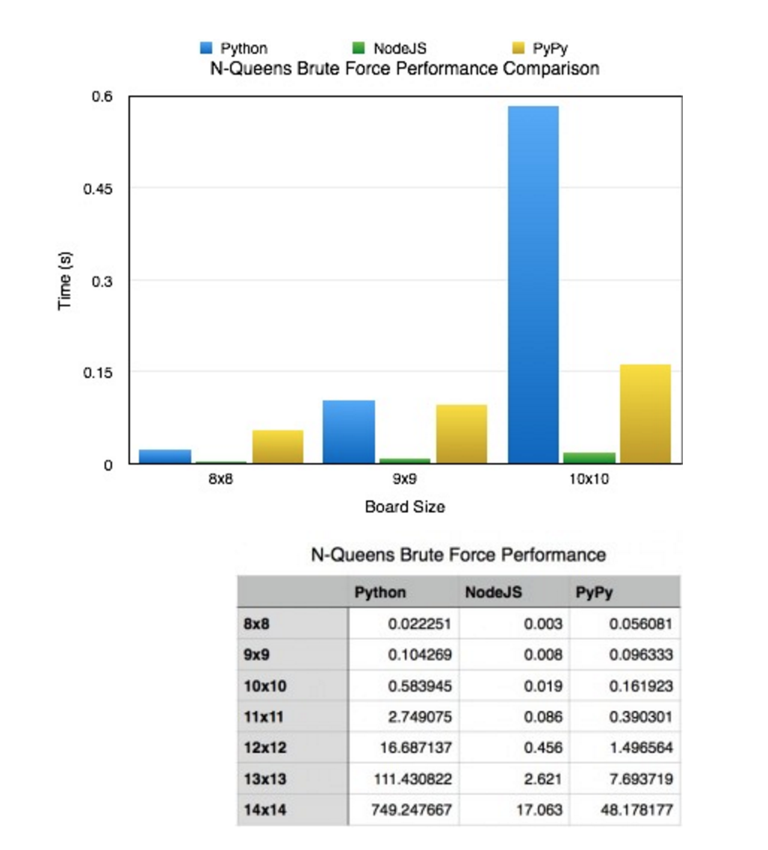
Node.js vs Python: Time Trials

Slide 11
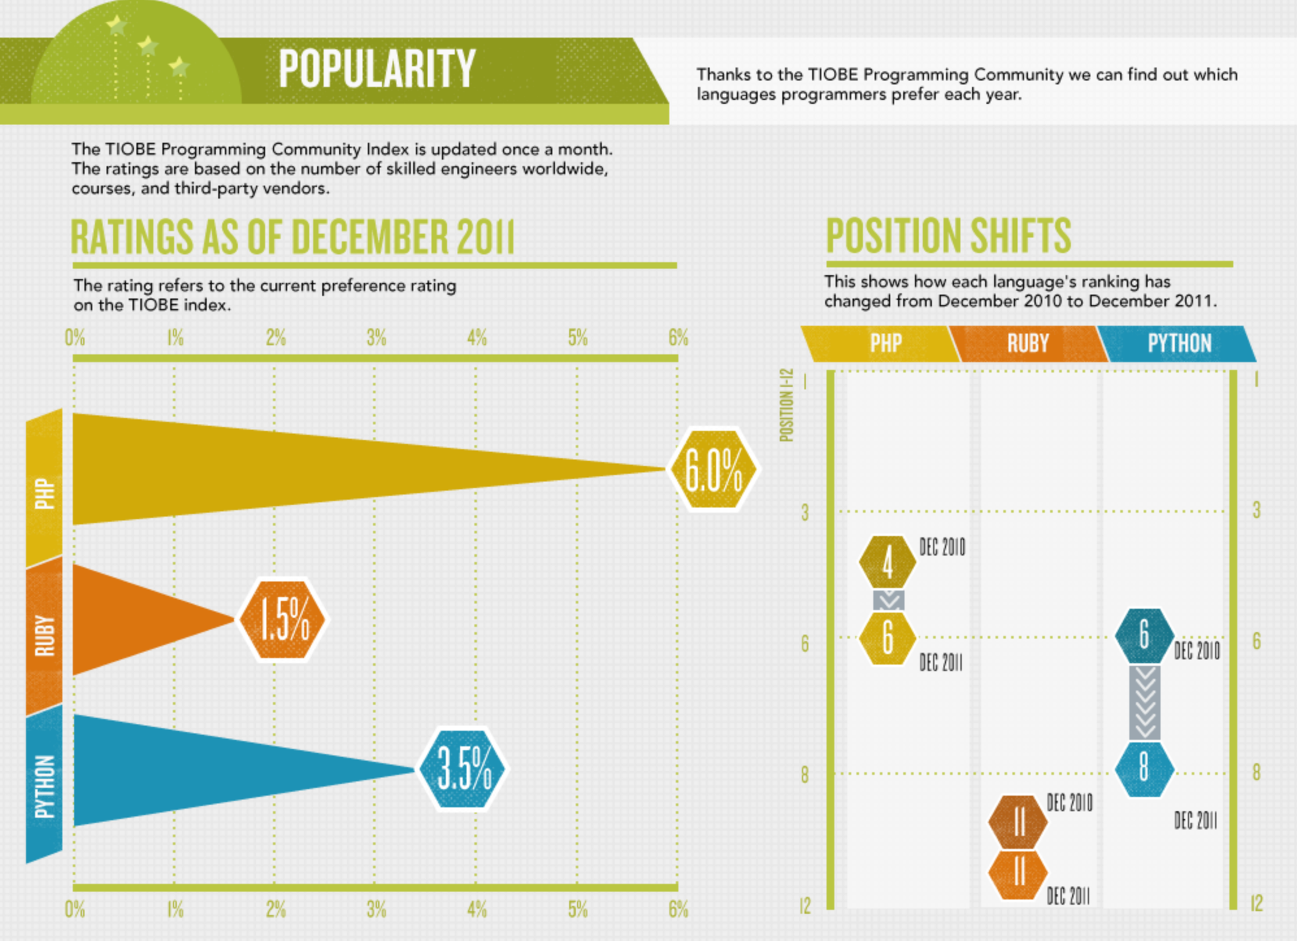
PHP vs Ruby vs Python
Current Ratings:
March 2016 | March 2015 | Change | Language | Ratings | Change
1 | 2 | /\ | Java | 20.528% | +4.95%
2 | 1 | \/ | C | 14.600% | -2.04%
3 | 4 | /\ | C++ | 6.72% | +0.09%
4 | 5 | /\ | C# | 4.271% | -0.65%
5 | 8 | /\ | Python | 4.257% | +1.64%
6 | 6 |  | PHP | 2.768% | -1.23%
7 | 9 | /\ | VisualBasic.net | 2.561% | +0.24%
8 | 7 | \/ | JavaScript | 2.333% | -1.30%
9 | 12 | /\ | PERL | 2.251% | +0.92%
10 | 18 | /\ | Ruby | 2.238% | +1.21%

Slide 12
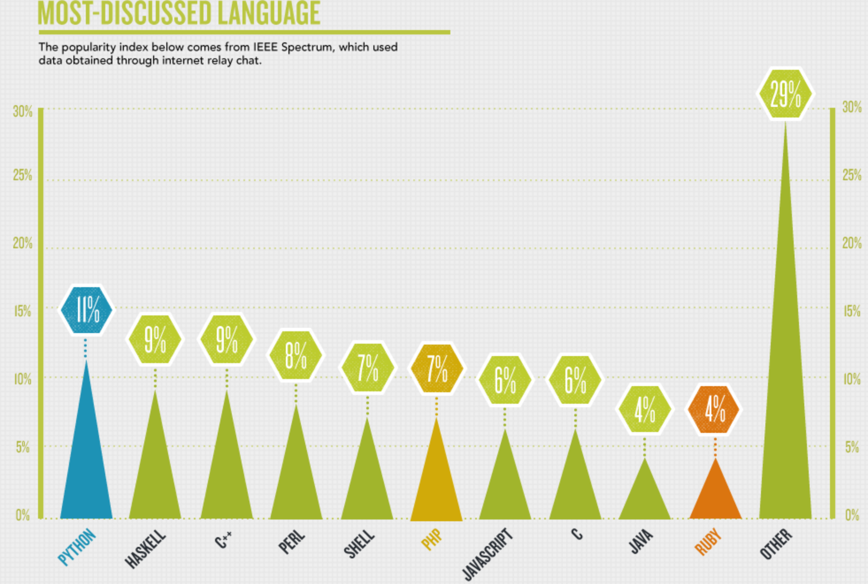
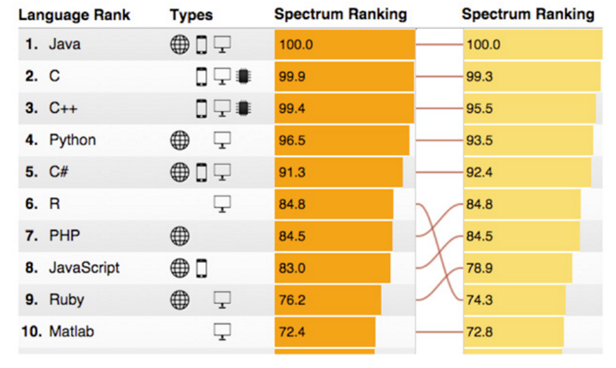
PHP vs Ruby vs Python
2015
Our ranking system is driven by weighting and combining 12 metrics from 10 data sources. We believe these sources—such as the IEEE Xplore digital library, GitHub, and CareerBuilder—are good proxies for the popularity of 48 languages along a number of different dimensions. The weighting of these sources can be adjusted in our interactive Web app to give, say, more importance to languages that have turned up in job ads. Filters can be applied so that you can see only languages relevant to mobile or embedded development, for example.
2011

Slide 13
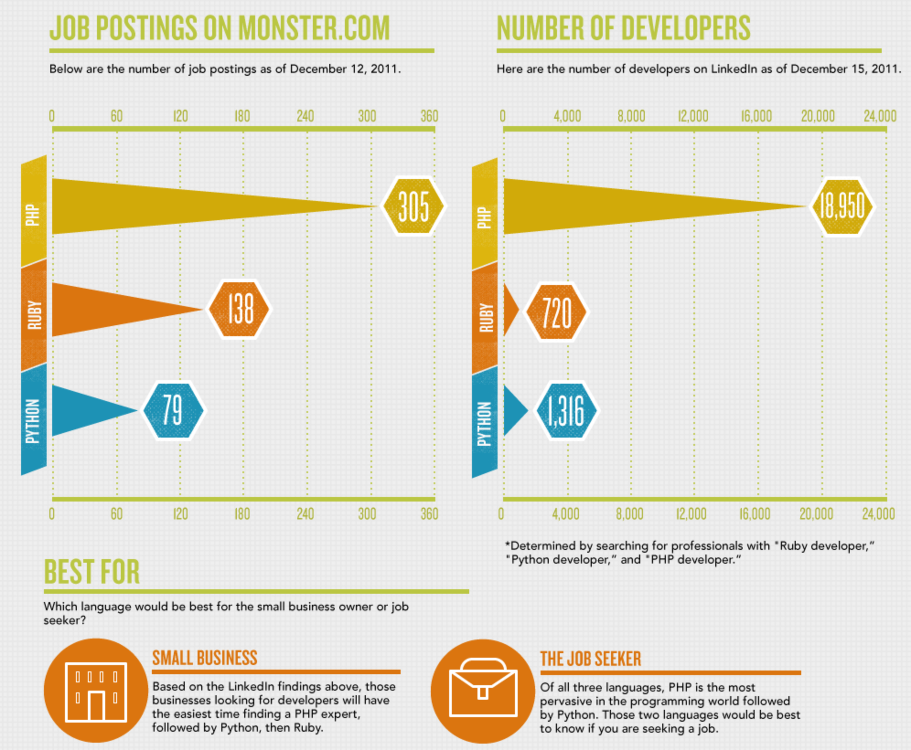
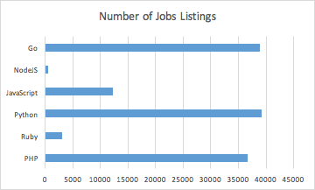
PHP vs Ruby vs Python
25 March 2016
Dice.com

Slide 14
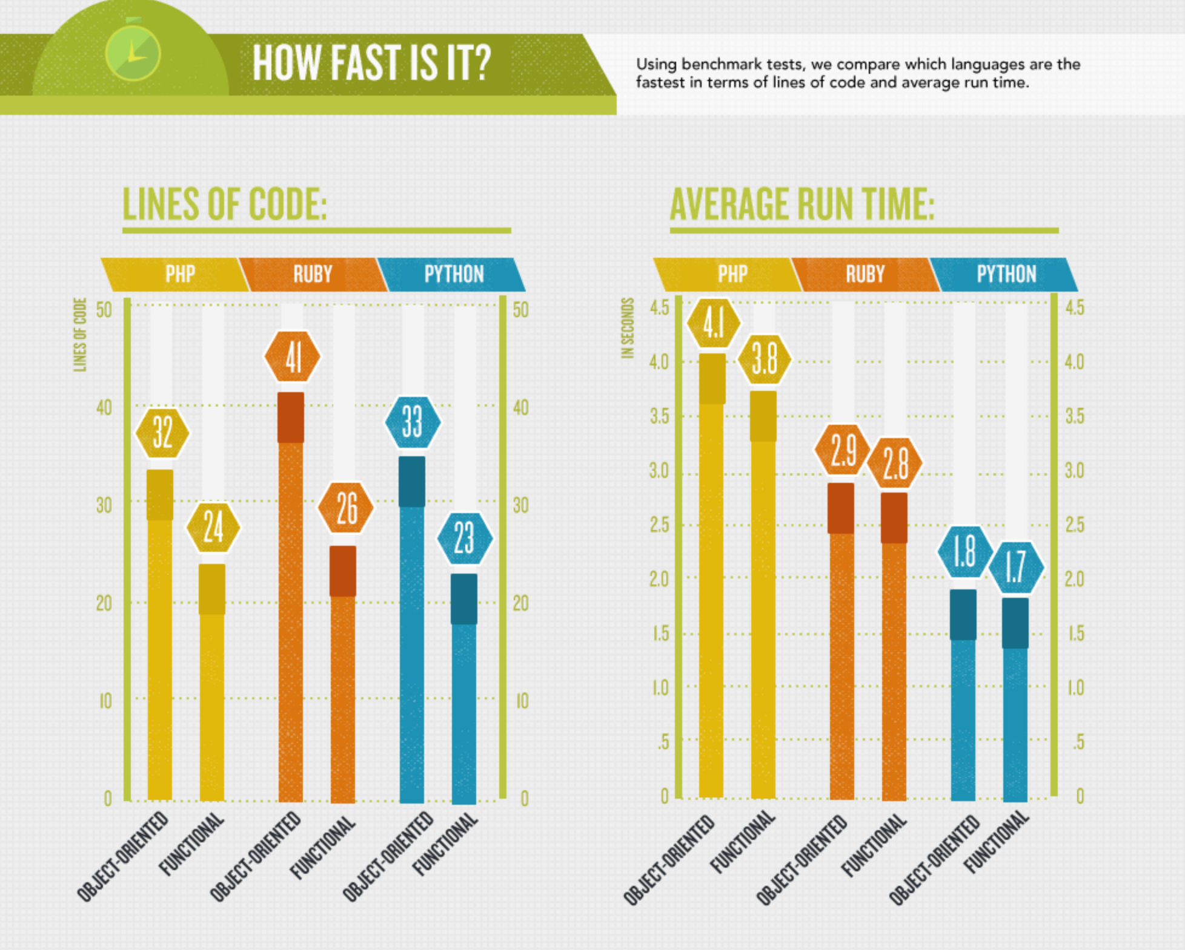
PHP vs Ruby vs Python

Slide 15
References
Cass, Stephen. The 2015 Top Ten Programming Languages. IEEE Spectrum. Retrieved 25 March 2016 from http://spectrum.ieee.org/computing/software/the-2015-top-ten-programming-languages
Doslinux. Language Strengths/Weaknesses. LinuxQuestions.org. Retrieved 25 March 2016 from www.linuxquestions.org/questions/programming-9/language-strengths-weaknesses-318606/
Dotson, Chad. NodeJs vs Python vs PyPy - A Simple Performance Comparison - Updated. Chad Dotson. Retrieved 25 March 2016 from http://www.cdotson.com/2014/12/node-js-vs-python-vs-pypy-a-simple-performance-comparison-updated/
Elke, Gregor. Is Node.js a Superhero? Codecentric. Retrieved 27 March 2016 from https://blog.codecentric.de/en/2014/06/node-js-superhero/
Orelly, Jordan. Why I went from Python to Go (and not node.js). JORDAN ORELLI. Retrieved 25 March 2016 from http://jordanoreii.com/post/31533769172/why-i-went-from-python-to-go-and-not-nodejs.
Querna, Paul. The Switch: Python to NodeJS. Paul’s Journal. Retrieved 25 March 2016 from https://journal.paul.querna.org/articles/2011/12/18/the-switch-python-to-node-js/
RENEE. Code Wars: Ruby vs Python vs PHP. Udemy Blog. Retrieved 25 March 2016 from https://blog.udemy.com/wp-content/uploads/2012/01/PROGRAMMING-LANGUAGE-3.png
Saurin, Alvaro. Comparing NodeJs with Python Solutions. Inercia. Retrieved 28 March 2016 from http://inerciatech.com/post/3147047471/comparing-nodejs-with-python-solutions-i

